Slide 1

Securing Admin Scripts with PSM & Credential Provider
Script identities can be unique, w/ access to different safes. Script editing can be prevented using hash authentication.
Admin access is authenticated and recorded
CyberArk Vault
Databases
Servers
Network Equipment
scriptA
CLI
CP
scriptB
CLI
Admins
PSM
Secure Script Server
Target Systems

Slide 2
Securing Admin Scripts with PSM & Central Credential Provider
CP
Admin access is authenticated and recorded
CyberArk Vault
Script identities can be unique, w/ access to different safes.
Databases
Servers
Network Equipment
scriptA
REST
scriptB
REST
Admins
PSM
Secure Script Server
Target Systems

Slide 3
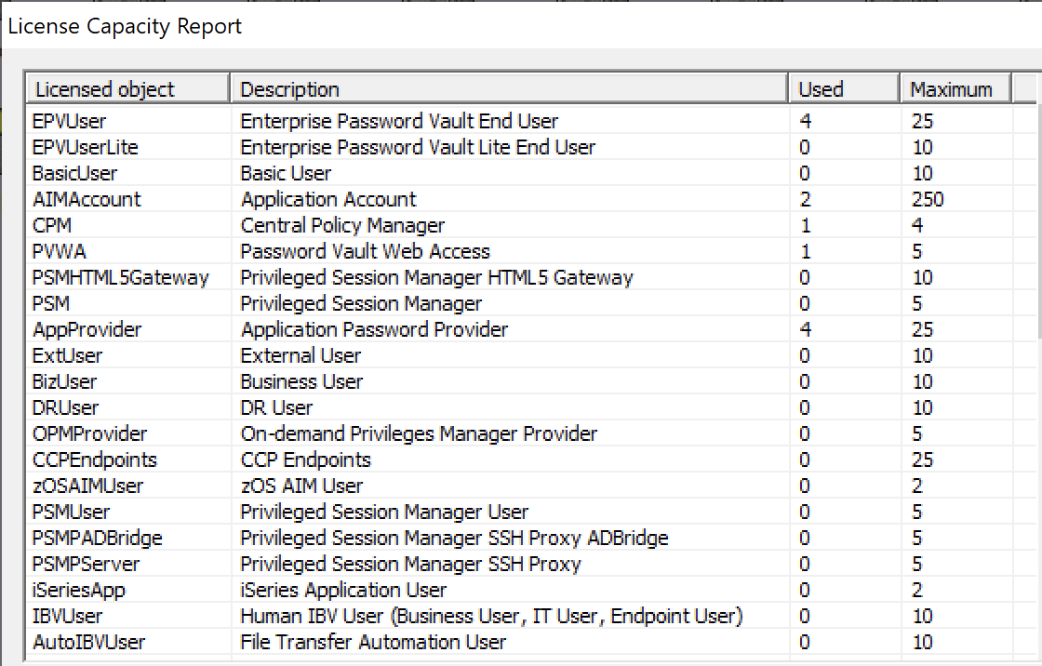
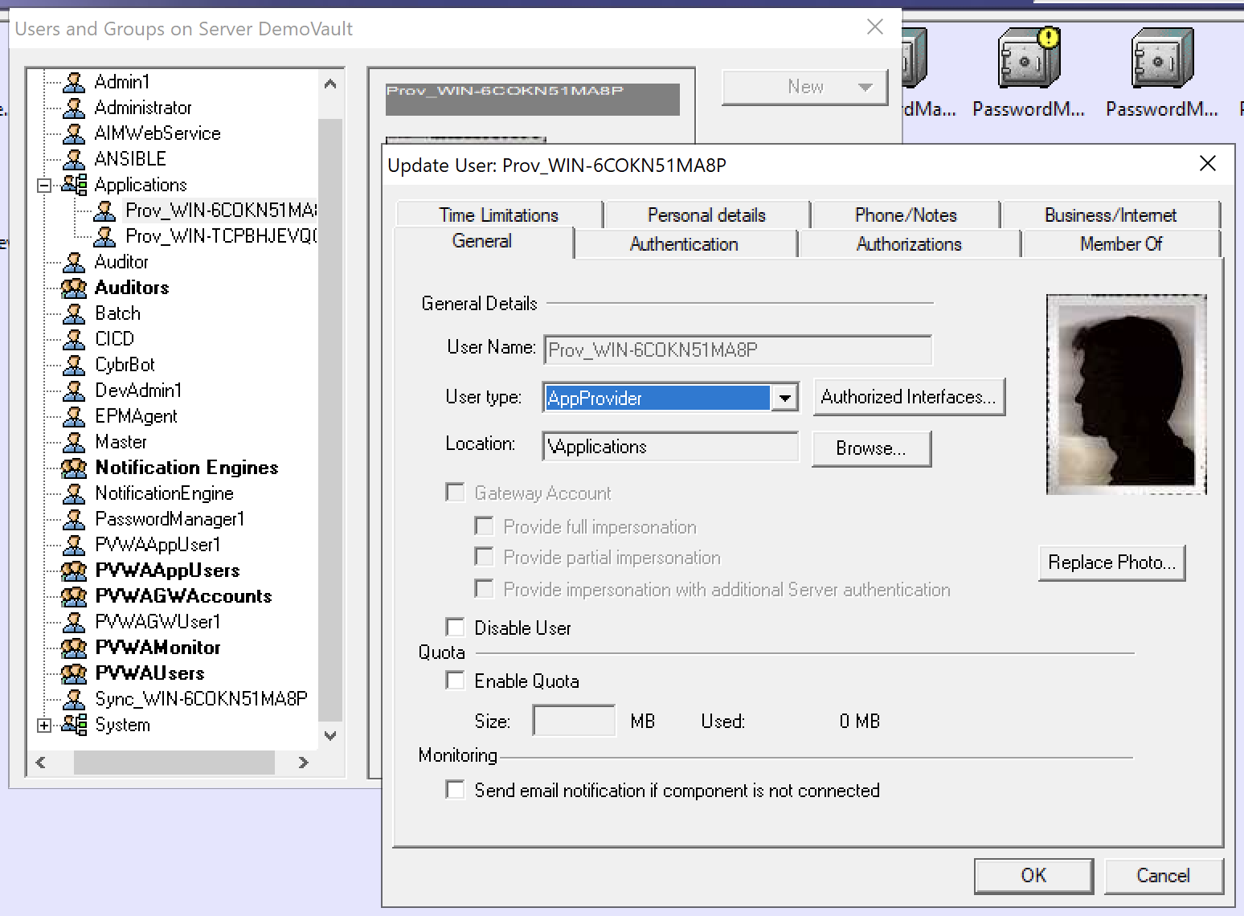
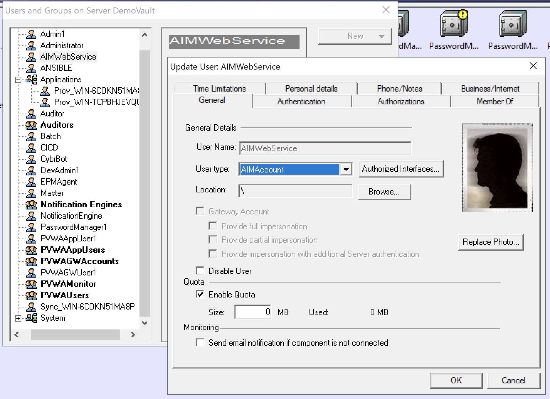
CyberArk Secrets Management CP Solution Licensing
AppProvider
AppProvider
AppProvider
Agent-Based
Agentless
CCPEndpoint
443
app
SDK
app
CyberArk
Vault
REST
CP
AIMAccount
CP
AIMAccount
1858
script
script
CLI
REST
Credential Provider
Central Credential Provider
AIMAccount
AIMAccount
AIMAccount
CP/CCP/ASCP Licensing Terminology
Represented in License Capacity Report:
AppProvider == Credential Provider agent
Licensed: APP_STATIC_xxx, APP_ISV_xxx, APP_RPA_xxx SKUs
Unlicensed (no $$): Sync/LOB users
Tracked & enforced by license manager
AIMAccount == Application ID (AppID) in PVWA
Not licensed (no $$), provided as ~10x AppProvider count
More can be allocated w/ support ticket
Tracked & enforced by license manager
CCPEndpoints == Calling system hosting apps calling CCP
Licensed: APP_STATIC_xxx, APP_ISV_xxx, APP_RPA_xxx SKUs
Not tracked or enforced by license manager
Licensing Terminology:
Calling System == a host/IP-address calling CP/ASCP/CCP
Primarily used for licensing custom/in-house built applications
Not represented directly in License Capacity Report
APP_STATIC_xxx SKU
Map to CP/ASCP AppProviders + CCPEndpoints
Third-party/ISV/RPA license units are product-specific
Robotic Process Automation (RPA) Solutions
APP_RPA_xxx SKU
Licensed per bot
Non-RPA solutions
APP_ISV_xxx SKU
Examples:
Vulnerability scanners -> licensed per scanning engine
ServiceNow -> licensed per mid server
Config
Files
J2EE App Server
CP
DS
app
Application Server Credential Provider
CPM Push-to-File
Conjur Enterprise
Calling System
Calling System
Calling System

Slide 4
Dynamic Access Provider (Conjur) OCP4 Lab Architecture
Windows Hosts
CyberArk Enterprise Password Vault
Synchronizer
Linux Host
L
OCP4 Cluster (AWS)
cybrlab Namespace
User Namespaces
F
Authen-ticator
Lab App
Service
Service

Slide 5
Four secrets access strategies for OCP/K8s
Lab 1:
Authenticator runs as a Sidecar
App pulls DB creds with REST API
App connects to DB
Lab 2: Summon
Authenticator runs as an Init container
Summon pulls DB creds & calls app w/ creds in env vars
App connects to DB
Lab 3: K8s Secrets
Authenticator runs as an Init Container
K8s secret manifest names DB cred names
Authenticator retrieves DB creds & dynamically patches K8s secret w/ DB cred values
App connects to DB
Lab 4:
Authenticator runs as a Sidecar Container listening on DB port
App attempts to connect to DB on local port
Authenticator retrieves DB creds, connects to DB, proxies connection for app
App connects to DB

Slide 6

Checklist
Goal: Come up with the functional and nonfunctional requirements and use cases:
Ability to inject secrets into K8s env variables (What is the best way to achieve this?)
What best practices should look like for managing secrets and K8s and what future options are
Review options for replacing secrets/service accounts in web.configs with show and tell
Review options for providing secrets to Azure DevOps specifically around integration testing with show and tell
Digi-Key would like to review the following workflow:
Sysadmin or developer creates a secret
A different developer can search for a secret through the UI
The developer can use secret in K8s (via injection into env variables)
Secret rotation in combination with injection
Digi-Key would also like to understand who has access to which secrets, and who is using which secrets - do we have reporting for this? Another option would be to bring authZ and utilization data into the IGA tool for access review etc.
Notes:
Secrets injection overview
Circle CI integration
K8s secrets provider
Github actions
GCP authentication & secrets retrieval
Service deployment – self-hosted or SaaS

Slide 7
Conjur OpenAPI Spec
Documents and describes the Conjur API in a machine-readable standard, OpenAPI Specification v3
Successor to Swagger
Swagger 2.0 was donated to the OpenAPI Initiative in 2015, included in the OpenAPI Specification v3.0 onward
Benefits to Customers
Multi-language support
Allow users to generate Conjur client libraries for their own use
If a user is trying to incorporate Conjur into their project for which CyberArk does not offer an official client, customers can generate a client from the OpenAPI spec instead of writing their own client/wrappers/HTTP requests
Integrations
Can be used to configure API gateways, eg.
AWS Gateway (https://docs.aws.amazon.com/apigateway/latest/developerguide/http-api-open-api.html)
Apigee (https://docs.apigee.com/api-platform/publish/specs/intro)
Can be imported to Postman for API experimentation/discovery
Benefits to CyberArk
Documentation
Single source of truth for the Conjur API
Development on the OpenAPI spec proved fruitful - we were able to document HTTP responses that weren’t previously, as well as specifying edge cases on a few endpoints that can take multiple URL parameters
Can use the OpenAPI description to generate human-readable documentation
Can generate Markdown/HTML documentation
Interactive API documentation with Swagger UI (https://swagger.io/tools/swagger-ui/)
Generated REST clients
Makes the Conjur SDK simpler to maintain
Previously, making a change to the Conjur API would mean each individual Conjur SDK would have to be updated with hand-crafted updates
If the Conjur SDK was generated from the OpenAPI spec, updating these clients would be as simple as generating a new batch of clients from the OpenAPI description

Slide 8
Secrets Management For Cloud, DevOps & Applications
Notes:
Today I’ll be talking about securing privileged access in the cloud at scale, and managing secrets within the DevOps Continuous Integration and Deployment Pipeline.

Slide 9


Everybody wants a secure DevOps flow, but…
Developers
Security
Good USER EXPERIENCE IS IMPORTANT!
So is collaboration!
Notes:
Show me the Dev$ecOp$
https://youtu.be/com/EMN47OtIhS0?t=5863

Slide 10
SHIFTING SECURITY LEFT INTO DEVELOPMENT WORKFLOWS
Plan
Code
Operate
Create
Test
Release
Deploy
Enable Developer/DevOps
Easy to use (consume secrets)
Prebuilt integrations
Open source and Secretless
Free developers from security burden
Compliance, audit requests, human creds
Security budget
Empower security team
Highlight the app & tool risk
Leverage single platform – human/non-human solution serves all
Security focus
Manage security budget
Developers
DevOps
Security

Slide 11









The Problem We’re Solving
There are lots of places to store secrets.
But:
Platform solutions only work for those platforms
Tool solutions lack security
Most not enterprise ready
Hard to share best-practices
SoD not enforced
IGA/GRC reporting is impossible
Heterogeneous Islands of Security
Home Grown Solutions
Secrets
Secrets
Hiera
Vault
Databags
IAM / KMS
IAM / KMS
IAM / KMS

Slide 12
Architecture

Slide 13
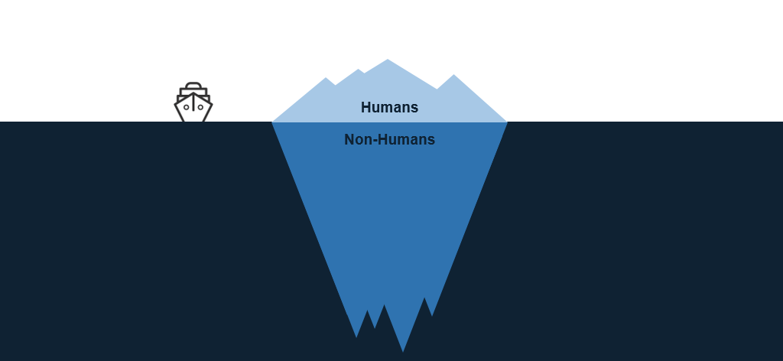
Human Access vs. Non-Human Access

Slide 14






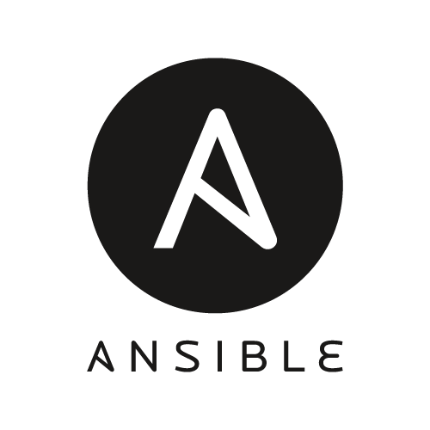




Cyberark secures the entire Supply Chain of Trust
Human Engineers
(Root)
Platform Access
Build/Test
Config/Deploy
Tools & Automation
(Intermediates)
Pre-Prod
Production
Version Control
Test Environments
Artifact Repository
On-Prem
Cloud
Apps & Target Systems
(End Entities)
Target Systems
Target Systems

Slide 15




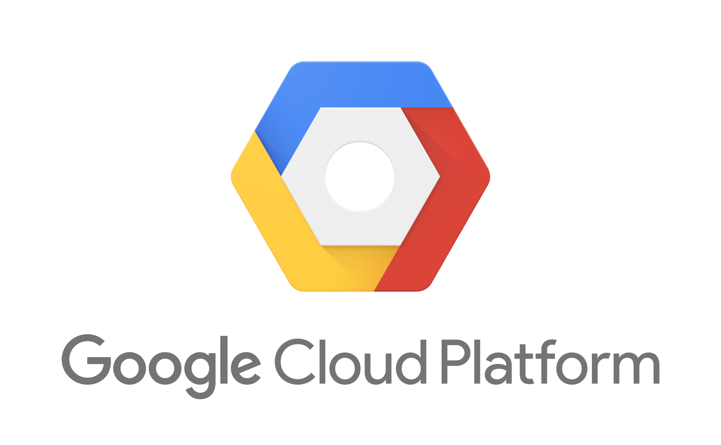
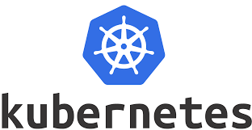







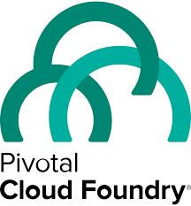
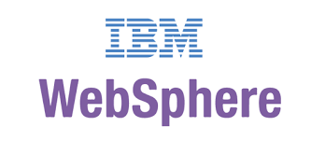







The Vision We’re Delivering On
Consistently enforce privilege security policies for both human users and non-human identities
Enterprise-Spanning Service delivered by IT Security
PAS
On-Prem Infrastructure and Apps
(*NIX, Windows, zOS)
IaaS
PaaS
DevOps Tools
App Servers and Custom Apps
Security
Solutions
IT Mgt
Software
RPA
Notes:
Only CyberArk offers an integrated solution for credentials and secrets management, regardless of the compute or development environment. Using a single control point to enforce consistent privileged security policies across the enterprise is a best practice for CISOs and IT leaders. And it’s something that we’re increasingly hearing from Gartner, Forrester and other analysts.

Slide 16








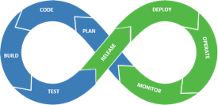
Centralized Audit, Security Policy, & Secrets Rotation
CyberArk
Vault
Consistent, Unified Enterprise-Wide PAS Program
Multi-Persona UI
PVWA
Conjur
CyberArk Secrets Management
Privileged Threat Analytics
CPM
PSM, OPM
Credential Providers
– Agent-based
Credential Providers
– Agentless

Slide 17
CyberArk Secrets Management - Solution Architectures
Agent-Based
Agentless
443
app
SDK
app
CyberArk
Vault
REST
CP
CP
1858
script
script
CLI
REST
Credential Provider
Central Credential Provider
Config
Files
J2EE App Server
CP
DS
app
Application Server Credential Provider
CPM Push-to-File
Conjur Enterprise

Slide 18
Conjur Demo Architecture
Windows Hosts
(my Mac)
CyberArk Enterprise Password Vault
Synchronizer
Linux Host
(my Mac)
L
Minikube K8s Cluster (my Mac)
cyberark Namespace
user1 Namespace
F
Authen-ticator
Demo App
Service
Service

Slide 19
Password change management w/ dual accounts
Initial State
Rotation 1
Synchronization
Rotation 2
Enterprise Password Vault
Active:
Inactive:
CPM Interval
Enterprise Password Vault
Inactive:
Active:
Sync Interval
Enterprise Password Vault
Inactive:
Active:
Grace Period
Enterprise Password Vault
Inactive:
Active:
acct1
acct1
acct1
acct1’
acct2
acct2
acct2
acct2
Synchronizer
Synchronizer
Primary
Primary
Primary
Primary
acct1
acct1
acct2
acct2
Follower
Follower
Follower
Follower
acct1
acct1
acct2
acct2
App A
App A
App A
App B
App C
App B
acct1
acct1
acct1
acct2
acct2
acct2
DB
DB
DB
DB
acct1
acct2
acct1
acct2
acct1
acct2
acct1’
acct2

Slide 20
Agenda
Use-cases
Cloud integration and capabilities (Conjur architecture with followers in cloud)
Summon utility
Terraform Enterprise (how can we integrate with Conjur?)
Terraform provider integration for cloud
Azure Authentication (All capabilities – System assigned, and user assigned managed identities)
AWS Authentication (short lived token using IAM role etc.)
Policy branch compared to Hashi namespace?
Discuss on a High-Level below capabilities
Lifecycle management - How to deploy applications, secrets managed along pipeline, applications rolled back, credentials deleted/rolled back
Zero Trust - Micro segmentation, workload security, human - human, machine - human. How is this concept applied from the product perspective?

Slide 21
Conjur Secrets Manager - Solution Architecture
Secrets Updates
Enterprise Vault
(system of record)
Audit Updates
Synchronizer
L
Leader/Standby
(update availability)
S
Followers
(service availability, scalability, accessibility)
F
F
Build Automation
Deployment Automation
Infrastructure Automation
Applications
Applications

Slide 22
Conjur Secrets Manager Architecture – Example
Enterprise Vault
Synchronizer
Primary cluster
DR
S
Async
L
Sync
S
S
LB w/ Health check
Cloud Region
On-Prem
OpenShift
/ K8s
F
F
F
F
F
F
LB
LB
LB
CI-CD Tools / Applications
CI-CD Tools / Applications
CI-CD Tools / Applications

Slide 23
Authentication

Slide 24



If it can be identified, Its access can be managed
Build on a chain of trust
Authenticate all requests
Authorize w/ least amount of privilege
Audit everything
...and do it with code!
The Secret-Zero Problem…
Humans have built-in authentication support:
Built-in vault for passwords
Back-channels for MFA (e.g. phones)
Non-humans need a way to bootstrap identity authentication that doesn’t put credentials at risk
But how to manage that initial secret required by apps to bootstrap identity?
Human Identity
Workload

Slide 25
Ways to establish & authenticate Identity
 | Use-Case | Means | Strengths | Weaknesses
Credential Based | Human identity | Passport, Password | Very familiar Humans have built-in vaults | Social engineering Insecure persistent storage
 | Pre-Configured Identity | API Key | Analogous to human uname/pwd model | Key distribution is subject to compromise Requestor can’t initiate
 | Bootstrapped Identity | Token-based | Can provide extra control factors, e.g. time, CIDR, one-time use, etc. | Secret to get a secret Stateful - requires active entropy mgmt
Attribute Based | Human Identity | Biometrics | Hard to spoof Convenient | Context dependent
 | Pre-Configured Identity | Various Factors | Multi-factor (selectable) OS user, path, MD5 hash, IP/Hostname | No trusted 3rd party Requires authn agent running local to applications Not scalable to container use-cases
 | Bootstrapped Identity | Trusted 3rd Party | Ideal for container orchestration | Platform dependencies Hard to implement for legacy technologies

Slide 26







IAM Role authentication in
1
Admin allowlists app identity with Conjur
Identity = app name + account # + IAM role
App gets signed header from platform service
App submits identity & signed header to Conjur
Conjur verifies header w/ platform service
Conjur issues Conjur access token to app
identity
Conjur policy
3
identity
header
5
access token
4
header
2
header

Slide 27
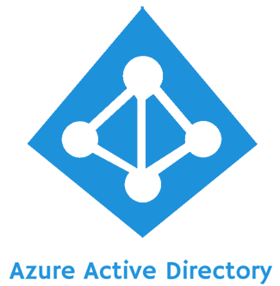
JWT authentication in
Azure AD V1 JWT:
{
"typ": "JWT",
"alg": "RS256",
"x5t": "nOo3ZDrODXEK1jKWhXslHR_KXEg",
"kid": "nOo3ZDrODXEK1jKWhXslHR_KXEg"
}.
{
…
"appid": "463be88f-d6af-4264-b3a2-048e5c3d9ea7", <-- AD-registered application UUID
…
}
1
identity
Conjur policy
Admin allowlists app identity with Conjur
Identity is a name annotated with value of JWT ‘appid’ claim:
463be88f-d6af-4264-b3a2-048e5c3d9ea7
App authenticates user w/ Azure AD, receives app-specific JWT
App submits identity & JWT to Conjur
Conjur verifies JWT w/ JWKS endpoint
Conjur issues Conjur access token to app
3
identity
jwt
5
access token
4
jwt
JWKS
2
jwt

Slide 28
Managed Identity authentication in
1
Admin allowlists app identity with Conjur
Identity is a name annotated with:
Subscription + Resource Group
Subscription + Resource Group + System-Assigned Identity
Subscription + Resource Group + User-Assigned Identity
App gets Azure access token (JWT) from IMDS
App submits identity & JWT to Conjur
Conjur verifies token w/ STS endpoint for tenant
Conjur issues Conjur access token to app
identity
Conjur policy
3
identity
jwt
5
access token
4
jwt
Metadata Service
2
jwt

Slide 29
JWT authentication in
Azure AD V1 JWT:
{
{
"alg": "RS256",
"kid": "Zx79NfQJZdTRLGiEbjiHG_9vhI_blwRGV-ZTqT5X0gk"
},
…
"sub": "system:serviceaccount:user1:app-example-authnjwt"
}
}
1
identity
Conjur policy
Admin allowlists app identity with Conjur
Identity is a name annotated with value(s) in JWT claims:
system:serviceaccount:user1:app-example-authnjwt
App gets service account JWT from pod filesystem
App submits identity & JWT to Conjur
Conjur verifies JWT w/ JWKS endpoint
Conjur issues Conjur access token to app
3
identity
jwt
5
access token
4
jwt
JWKS
/run/secrets/k8s.io/sa/token
2
jwt

Slide 30
K8s attribute authentication in
1
Admin allowlists app identity with Conjur
Two options for identity granularity:
Identity = Cluster/Namespace
Identity = Cluster/Namespace/Service Account
Authenticator client in app pod submits CSR w/ platform attributes to Conjur
Conjur verifies attributes w/ platform service
Conjur issues cert & key creds to authenticator client in app pod
Authenticator client in app pod uses creds to authenticate, get Conjur access token and shares via shared memory volume.
identity
Conjur policy
2
csr
4
5
3
verify
access token
Notes:
K8s secrets risks: https://kubernetes.io/docs/concepts/configuration/secret/#risks

Slide 31
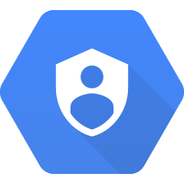
Managed Identity authentication in
1
Admin allowlists app identity with Conjur
Identity is a name annotated with:
instance-name (GCE only)
project-id (GCE only)
service-account-id
service-account-email
App gets GCP access token (JWT) from IAM service
App submits identity & JWT to Conjur
Conjur verifies token w/ IAM service
Conjur issues Conjur access token to app
identity
Conjur policy
3
identity
jwt
5
access token
4
jwt
2
Cloud IAM
jwt

Slide 32



Summon for Secrets Injection
1
2
Summon invoked with authenticated identity
1
2
Summon fetches secrets using identity
3
3
Processes launched with secrets in environment
Learn more at: https://cyberark.github.io/summon/

Slide 33
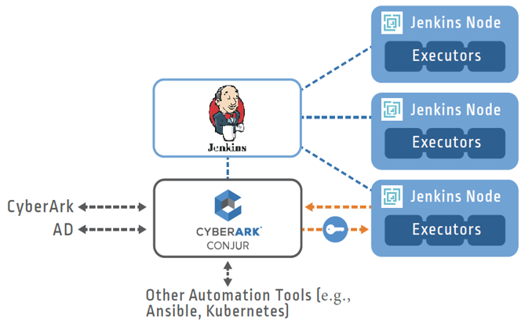

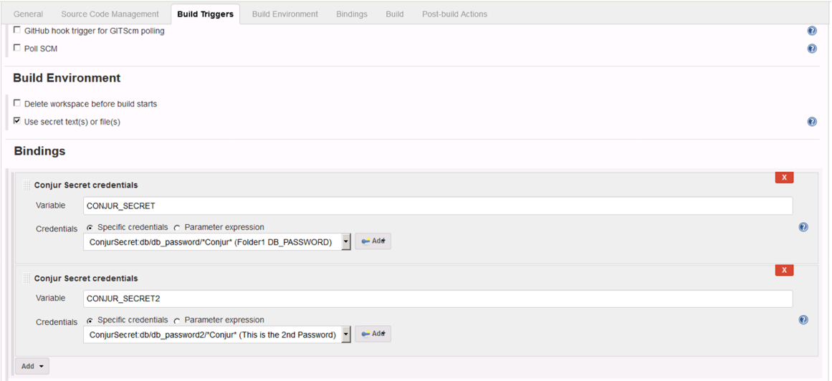

Orchestrating the Pipeline
Utilize recommended best practices with jenkins
Use Jenkins Pipelines to your advantage
Ephemeral Jenkins Slaves (Executors) via Docker
Utilize Kubernetes or OpenShift as much as possible
This allows for attribute-based authentication, no secret zero!
Establish Machine Identity on Ephemeral Nodes
Use Credentials Plugin for Secure Secrets Delivery
Notes:
Go in-depth with Conjur vs. AIM and why.why not

Slide 34


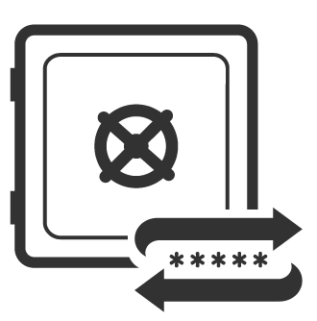





Central Credential Provider
Centralized, agentless approach
HTTPS
Application
Username = GetUserName()
Password = GetPassword()
Host = GetHost()
ConnectDatabase(Host, Username, Password)
Central Credential Provider
Agentless, web service-based application secrets management solution
Eliminates risk from hard-coded application credentials
Platform agnostic
Alleviates deployment overhead
Target System
CyberArk Vault

Slide 35

Credential Provider
High performance and availability
SDK
Application
Credential Provider
CyberArk Vault
Application Server
Username = GetUserName()
Password = GetPassword()
Host = GetHost()
ConnectDatabase(Host, Username, Password)
In case a network outage should occur, credentials will always be available from the secure local cache
Target System

Slide 36
Secrets Access Workflow
Requestor
Conjur Follower
Target
Authenticate
Access Token
Access per Policy
Retrieve secrets
Use secrets
Access Token expires after 8 mins
Audited activity

Slide 37
K8s Application Options with Conjur
Attribute-Based Authentication (authn-k8s)
App retrieves secrets
Authenticator runs as a sidecar or init container
App pulls secrets with REST API (or Summon)
K8s secrets
K8s Secrets Provider runs as an init container or job
Manifest for K8s secrets contain Conjur maps
Provider parses Conjur map, retrieves secrets & dynamically patches K8s secrets w/ secret values
Secrets pushed to file
K8s Secrets Provider runs as an init container or sidecar
Manifest for pod contains annotations w/ Conjur map and file format specs
Provider parses annotations, retrieves secrets & writes secrets to pod’s filesystem in specified format
Secretless
Secretless Broker runs as a sidecar listening on pod port(s)
App attempts connection on local port
Broker retrieves secrets, proxies connection for app
JWT Authentication (authn-jwt)
App retrieves secrets
App authenticates with service account JWT
App pulls secrets with REST API (or Summon)

Slide 38
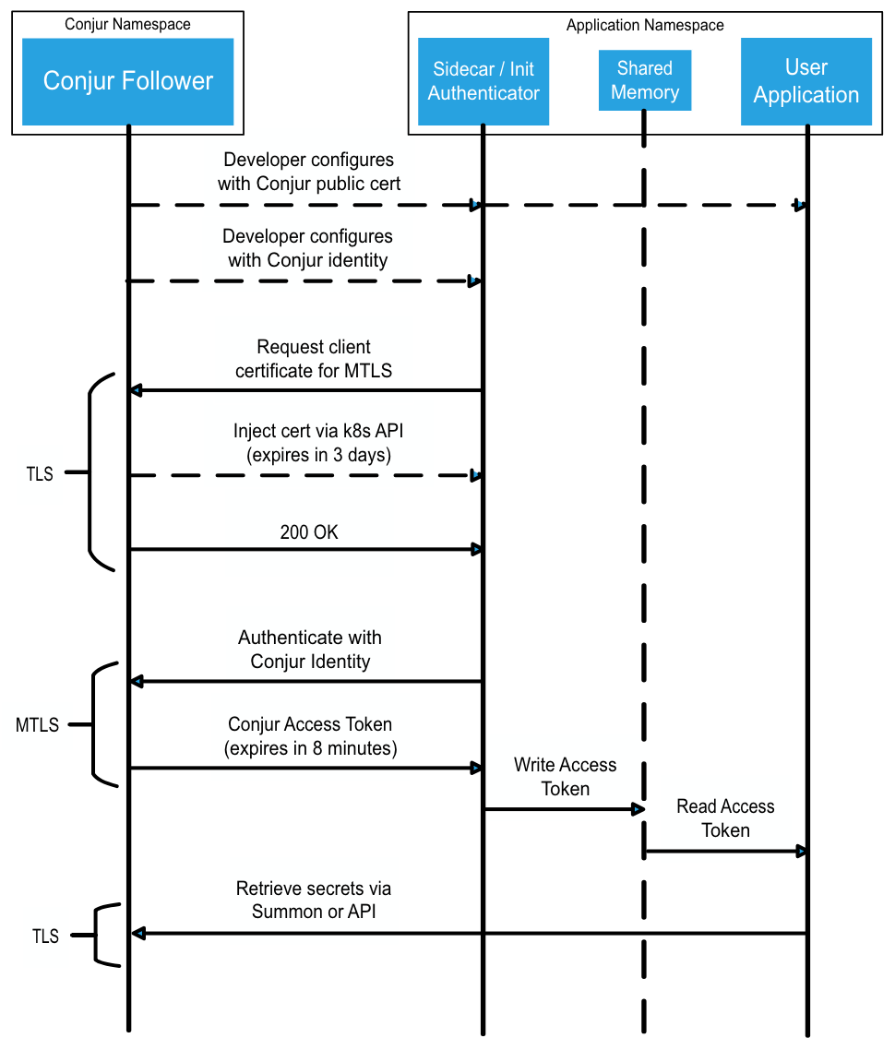
Openshift/ K8s authn flow
CyberArk Conjur Service
authentication client container
Shared memory volume
application container
Deployment
manifest
Login
Authentication
Secrets retrieval

Slide 39
Encryption-as-a-Service

Slide 40

Thales Cipher Trust & Cyberark conjur
Thales Cipher Trust Solution provides:
On Demand Encryption/Decryption
Data Tokenization
Transparent Database Encryption
Workflow:
CyberArk CPM manages the Thales CipherTrust password.
Apps authenticate to Conjur to retrieve the Thales CipherTrust password, gaining access to encryption services and keys.
Together, the Thales CipherTrust Solution and CyberArk Secrets Manager are the best-of-breed solution for ephemeral data protection needs.
Solution page: https://cpl.thalesgroup.com/encryption/data-security-platform

Slide 41

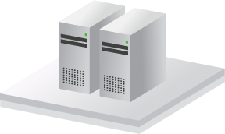
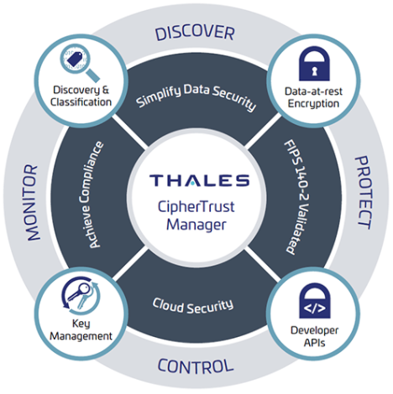
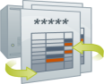

Thales/Cyberark integration workflow
CyberArk CPM manages the CipherTrust password.
The password is synchronized to CyberArk Conjur.
The Application authenticates to Conjur and retrieves the CipherTrust password.
The Application Logs into CipherTrust to complete encryption/tokenization tasks.
2
CyberArk Vault
Conjur
3
Application
1
4
Central Policy Manager

Slide 42
Developer Experience

Slide 43
The Secrets Lifecycle Today
Secrets Storage
Secrets Delivery
Applications

Slide 44


“Secretless” concept: Apps can’t leak secrets
LDAP, htpasswd, etc.
2
4
Conjur Follower
User authn
K8s Pod
HTTP Request
1
3
User (Simulated)
Billing Service
Secretless
Database
Service connects to Secretless proxy
Secretless establishes a connection to the remote database and transparently brokers the connection
1
3
Secretless proxy requests database credentials to remote database
Conjur seamlessly rotates database credentials used by Secretless
2
4

Slide 45

“Secretless” Security Management Centralized Governance & Workflows
Secretless
Server
Traffic Analysis
Notify and respond to abnormal traffic patterns
Traffic Filtering
Blacklist certain keywords or message types sent from the client
Access Restrictions
Based on time, service type, geography or human intervention
Streamlined application onboarding workflows
Out of the box or plugged into your existing ticketing system
Detailed audit logs and metadata aggregation
Provide deep context to facilitate faster, well-informed decision making
Reporting & Policy
Enforcement
Request
Authenticated Request
Client Application
Secretless

Slide 46
Policy Reference Model
Managed by Conjur admin process
Managed by Synchronizer
Managed by Conjur admin process
/
conjur
Vault
appteam1
appteam2
authn-k8s
SyncTag1
consumers
consumers
cluster-id
appteam1-safe
hosts
hosts
authn-azure
appteam2-safe
tenant-id
Managed by project admin process

Slide 47
Identity definition & permissions grants by app teams
Managed by privileged Conjur admin (process):
Managed by app team admin:
#======================
# APPTEAM1 ROOT POLICY
# AppTeam Policy Template where policy namespace = EPV safe name
# Creates admin identity to delegate policy mgmt and role to grant authn to app identities.
# This policy must be bulk-loaded with other root policies.
# Create one policy for each application team, named for the application team.
#======================
# Admin identity w/ CIDR limitation
- !host
id: appteam1_svc
restricted_to: 172.17.0.3
# Create root policy for appteam1
- !policy
id: appteam1
owner: !host appteam1_svc
body:
- !group consumers
# Grant cross-platform authn to appteam1/consumers role
- !grant
roles:
- !group conjur/authn-iam/lab/consumers
- !group conjur/authn-azure/lab/consumers
- !group conjur/authn-k8s/lab/consumers
- !group LabVault/Labs/LabSafe1/delegation/consumers
members:
- !group appteam1/consumers
# END APPTEAM1 ROOT
#======================
# APPTEAM1 IDENTITIES
# Policy defined & managed by the application team.
# Defines application identities “under” the app team’s root policy.
# Applied using appteam1_svc account at /appteam1 w/ --replace
#======================
- &hosts
- !host aws-app/475601244925/GenericReadOnly
- !host
id: azure-app
annotations:
authn-azure/subscription-id: a01ff134-ae78-4497-b11c-7a698736b8a0
authn-azure/resource-group: appteam1
authn-azure/user-assigned-identity: appteam1-UA-Identity
- !host
id: k8s-app
annotations:
authn-k8s/namespace: appteam1
authn-k8s/service-account: appteam1-app1
authn-k8s/authentication-container-name: authenticator
- !grant
role: !group consumers
members: *hosts
# END APPTEAM1 IDENTITIES

Slide 48
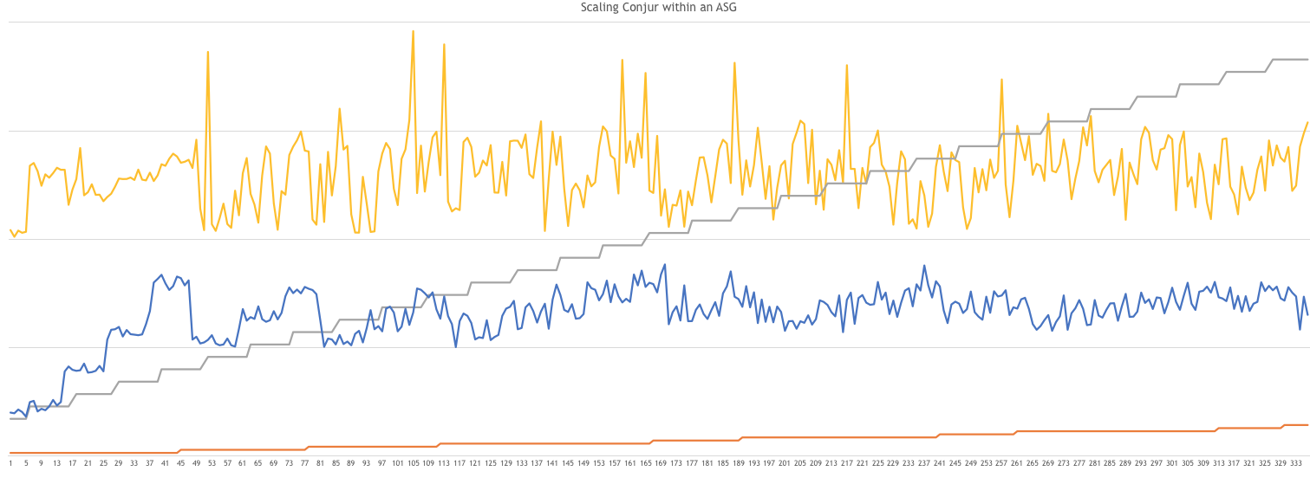
Elastic Scale Out Performance
140
105
70
35
0
Read Requests
(each step = 20/sec)
# Followers
Avg CPU%
Avg Latency (ms)

Slide 49
Production ocp deployment - performance
4 clusters, retrievals/hour/cluster w/ application cache (hash table, 15 min TTL)

Slide 50
Production OCP deployment – resource consumption
1 of 4 clusters, 5 followers/cluster

Slide 51
Next Steps…

Slide 52
Integrations

Slide 53
RPA: Integration Overview & Benefits
Challenges without CyberArk CCP integration
Sensitive data stored in two places:
CyberArk EPV & RPA Credential Vault
Extra effort in maintaining data security at two places.
User access to copy/paste sensitive data from CyberArk to RPA solution
Sensitive credentials exposed to multiple users
Benefits of CCP integration
Credentials securely stored in CyberArk EPV
CyberArk manages access to & automatically rotates credentials
No User access - credentials only accessible to authentication bots
Credentials securely retrieved as needed for robots to perform their functions
All access captured in audit logs
Client stays in compliance with corporate policies and industry guidelines
Integration implemented and supported by vendors

Slide 54
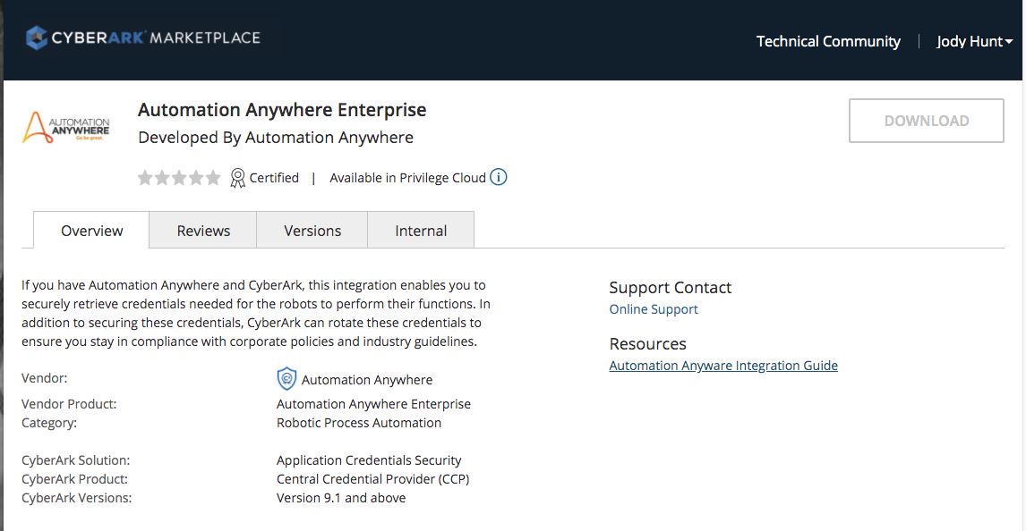
Automation Anywhere: Integration offered in CyberArk Marketplace

Slide 55
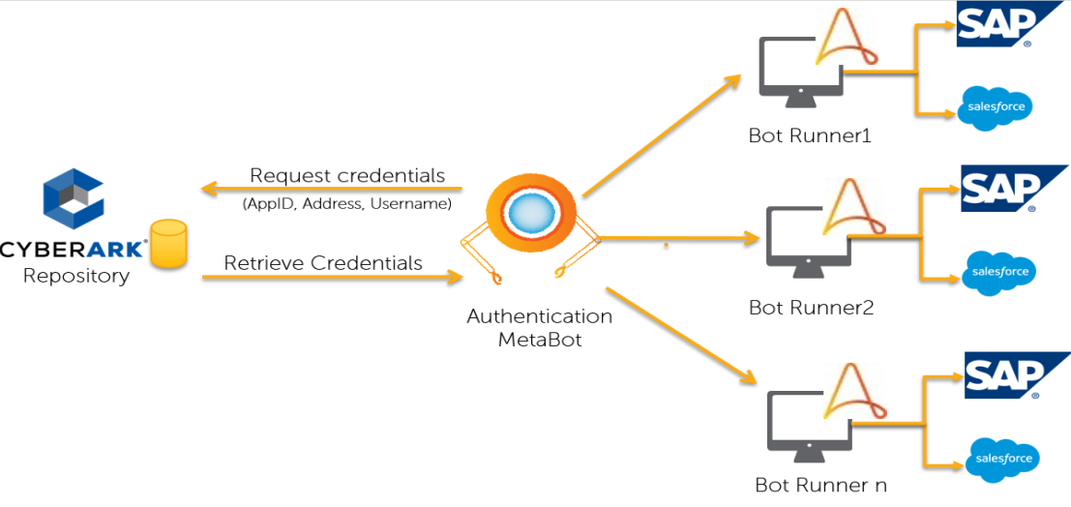
Automation Anywhere: Solution architecture with CyberArk CCP

Slide 56
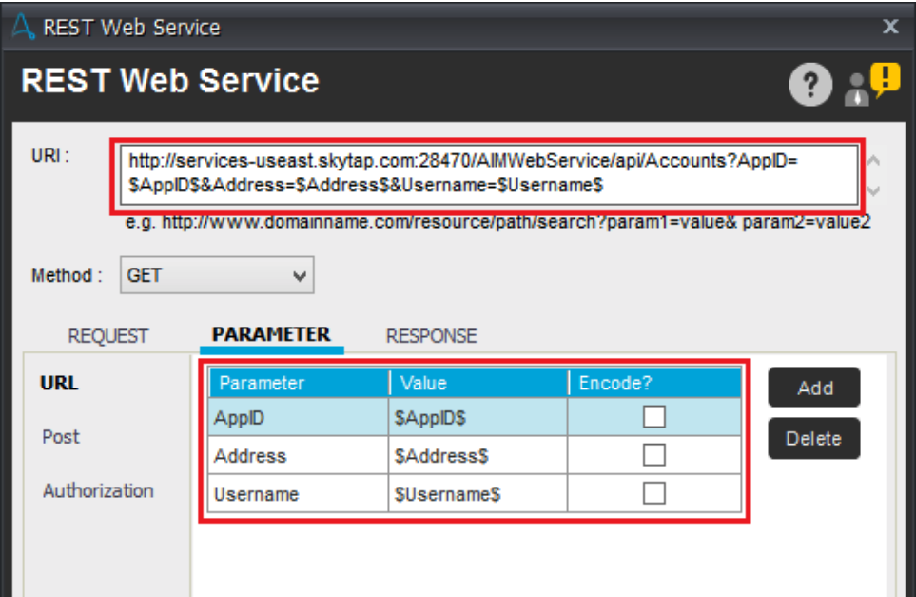
Automation Anywhere: Configuring Metabot connection to CCP

Slide 57
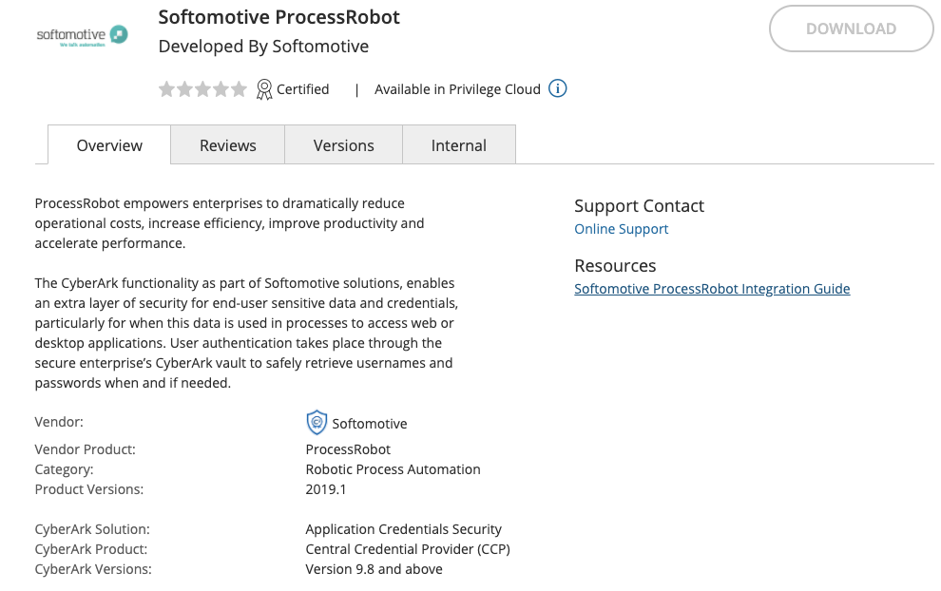
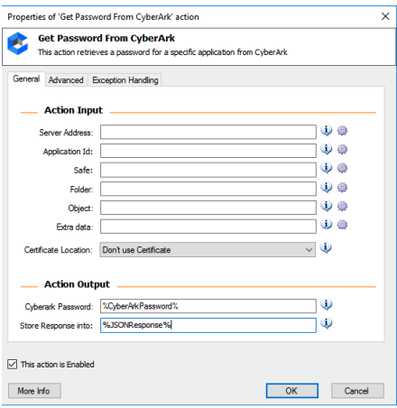
Microsoft Power Automate
Formerly softomotive
Benefits of CCP integration
Credentials securely stored in CyberArk EPV
CyberArk manages access to & automatically rotates credentials
No User access - credentials only accessible to authentication bots
Credentials securely retrieved as needed for robots to perform their functions
All access captured in audit logs
Client stays in compliance with corporate policies and industry guidelines

Slide 58
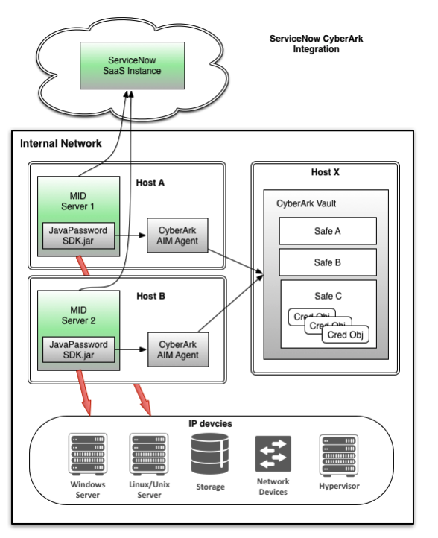
ServiceNow
Challenges without CyberArk CP integration
Sensitive data stored in two places:
CyberArk EPV & ServiceNow Instance
Extra effort in maintaining data security at two places.
User access to copy/paste sensitive data from CyberArk to ServiceNow console
Sensitive data exposed to multiple users
Benefits of CP integration
Enables Orchestration, Discovery, and Service Mapping to run without storing any credentials on the instance
Credentials securely stored in CyberArk EPV
CyberArk manages access to & automatically rotates credentials
No User access - credentials only accessible to MID Servers
Credentials securely retrieved as needed to perform functions
All access captured in audit logs
Client stays in compliance with corporate policies and industry guidelines
Integration implemented and supported by ServiceNow

Slide 59
OpenShift/Kubernetes Integration
Securely provide secrets to applications
Seamlessly integrates into the OpenShift/k8s environment
Strong container authentication based on its attributes
Central audit
Secret rotation
Notes:
Low maintenance using wrapper or init container solutions – no need to care about re-login when secrets rotation

Slide 60
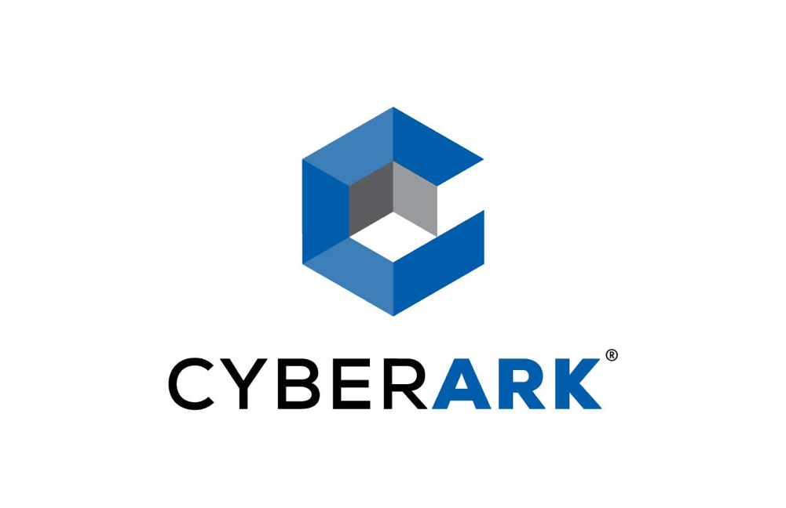
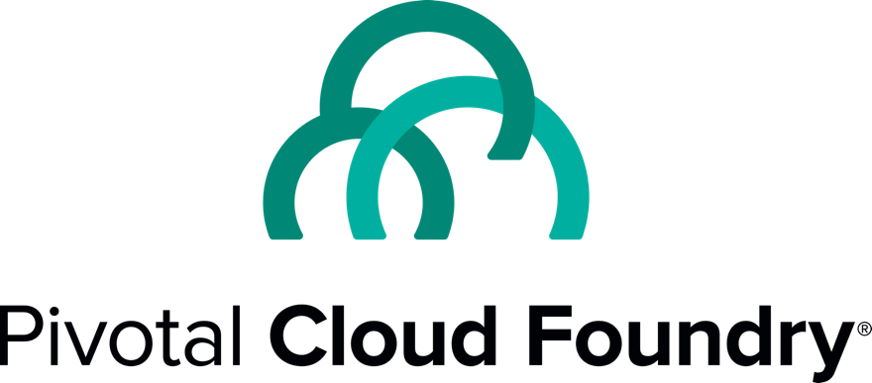
Partners in Enterprise Security
Both organizations are focused on best in class security solutions for Pivotal Cloud Foundry deployments and workflows.
Strong partner relationship and many shared customers.
Solution developed in collaboration with Pivotal R&D.
Notes:
Key takeaway: CyberArk and Pivotal are working together to secure Pivotal Cloud Foundry.

Slide 61
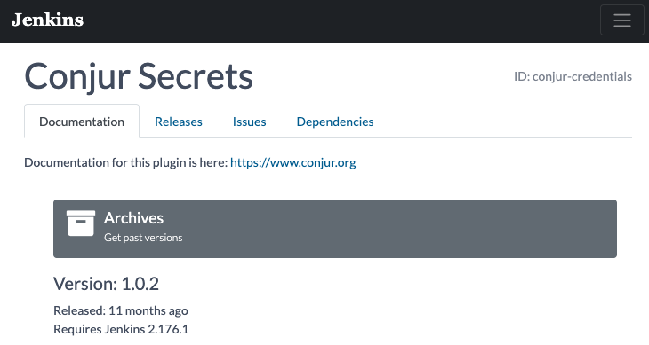
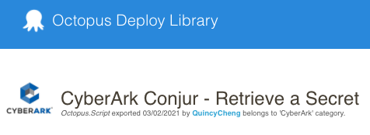
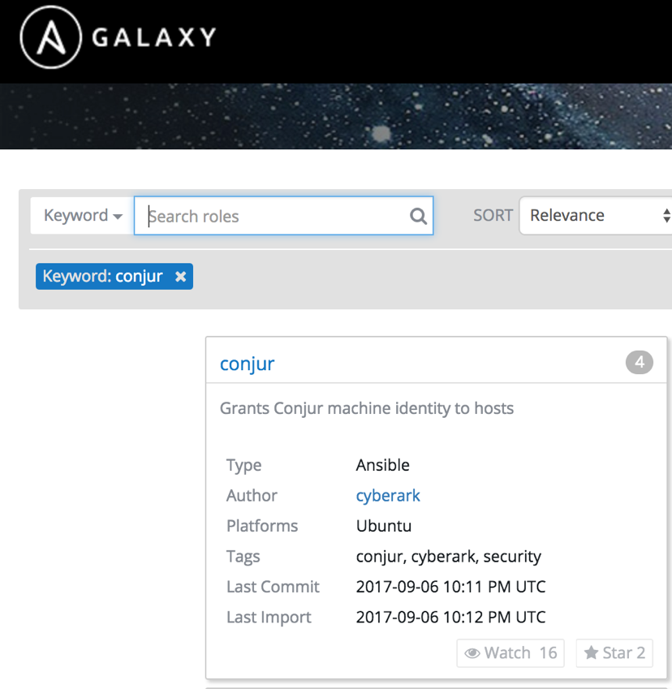
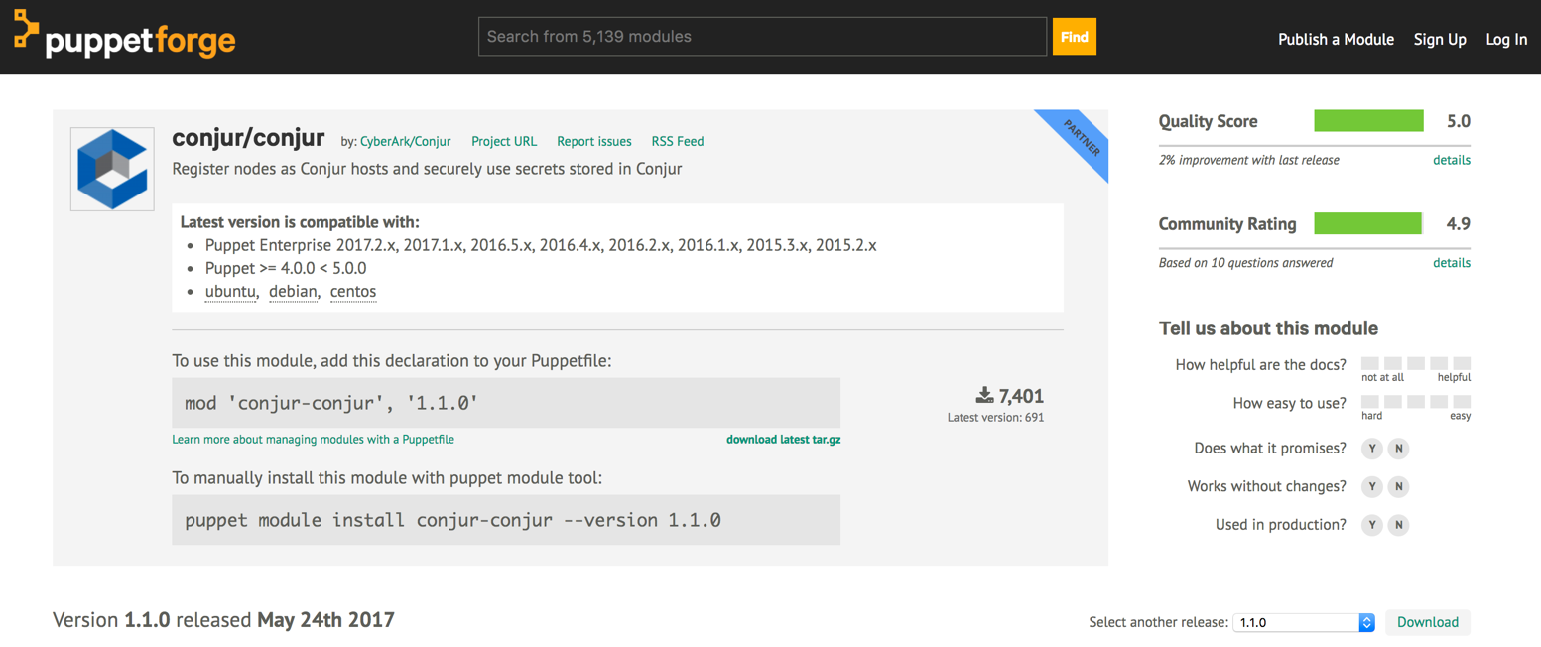
Example CI/CD Integrations

Slide 62


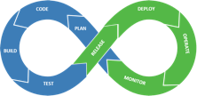



Aqua Security – CyberArk Conjur Integration No container downtime or restart
Conjur
Discover embedded secrets in images & containers
Securely inject secrets into runtime containers (no container downtime/restart for business continuity)
Encrypt secrets in transit and in memory (never persist on disk)
Secrets visible inside the container only, not visible to host or orchestrator
Rotate secrets with no container downtime/ restart
Manage, monitor, and audit container access to secrets
Enable secrets segregation by assigning labels (e.g. namespaces) to secrets and create security policy to allow only specific workloads to use specific secrets based on labels
Automatically provision, secure, and manage secrets
Registries
CI/CD
Cluster
Image Scanning
RBAC
Secrets
Image Assurance
Runtime Protection
Container Firewall
Compliance
Aqua Enforcer
Container
Aqua
Cyber Intelligence
Secure secrets delivery with no container downtime/restart
Container
Container
Container
CaaS
Container

Slide 63
Azure Authentication Details

Slide 64
Authn-Azure: Identity validated by Azure
Instance Metadata Service (IMDS)
http://169.254.169.254/metadata/identity/oauth2/token?api-version=2018-02-01&resource=https://management.azure.com/
Issues Azure access tokens (jwt)
Validates Azure access tokens for identities in Tenant
Tenant(s)
Provider URI: https://sts.windows.com/<tenant-id>
Subscription(s)
Resource Group(s)
“Group” Identity
CyberArk Conjur
System-Assigned Identities
User-Assigned Identities

Slide 65
Authn-k8s: Identity validated by K8s
Cluster(s) Conjur Authenticator ID
Namespaces(s)
Namespace
Identities
Deployment(s) Stateful Set(s) Daemon Sets(s) Replica Set(s) Pod(s)
etc.
Service Account Identities

Slide 66
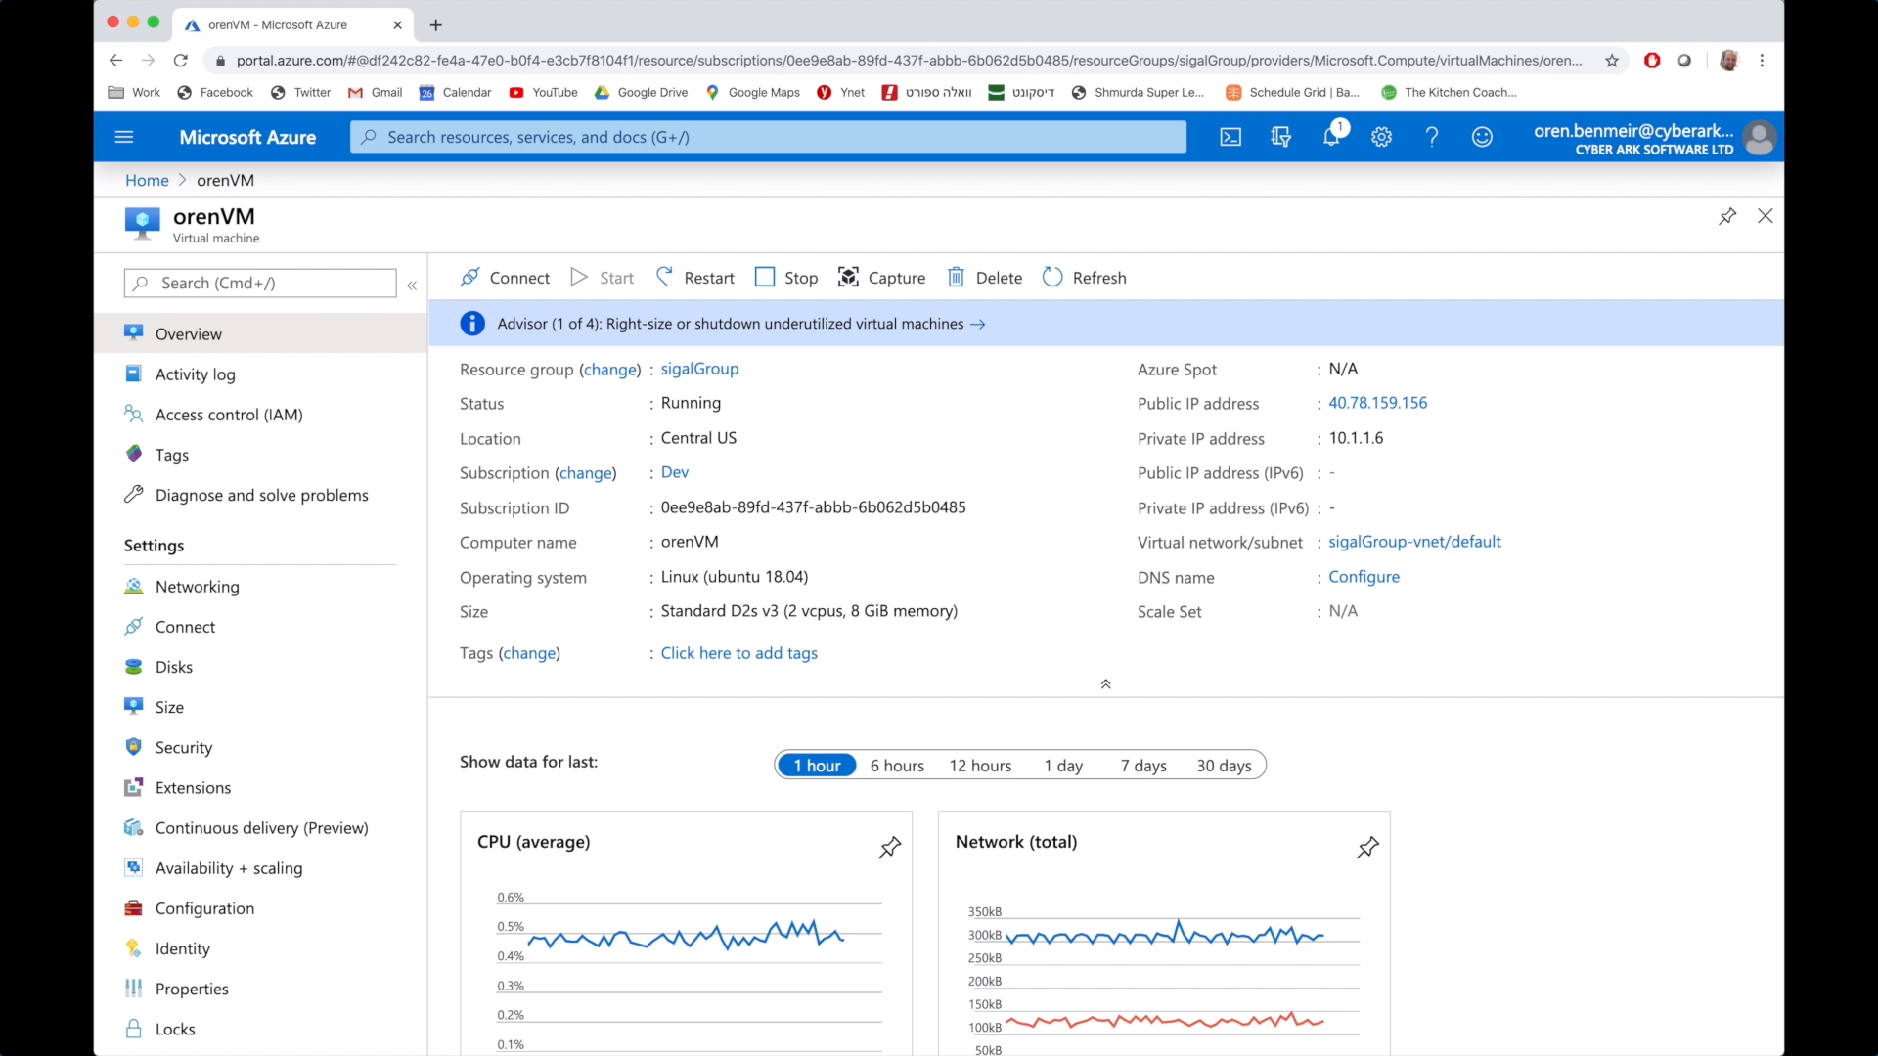
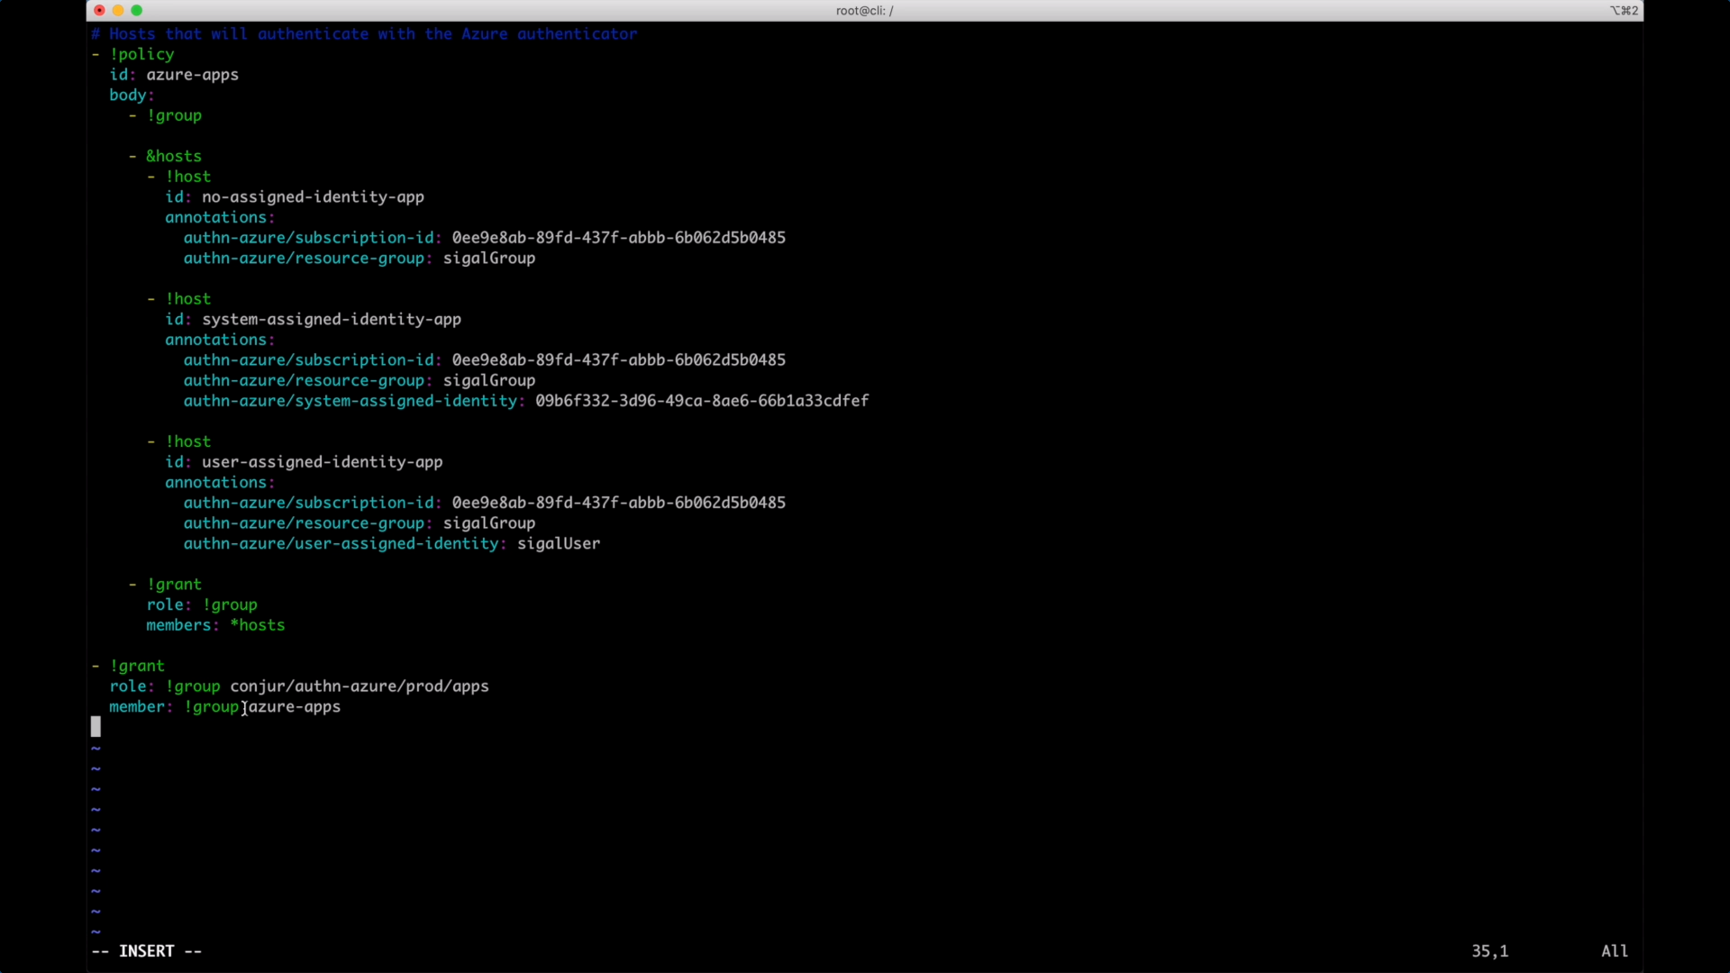
Azure Identity Option 1:
Subscription ID + Resource Group
Identity definition in Conjur Policy yaml:

Slide 67
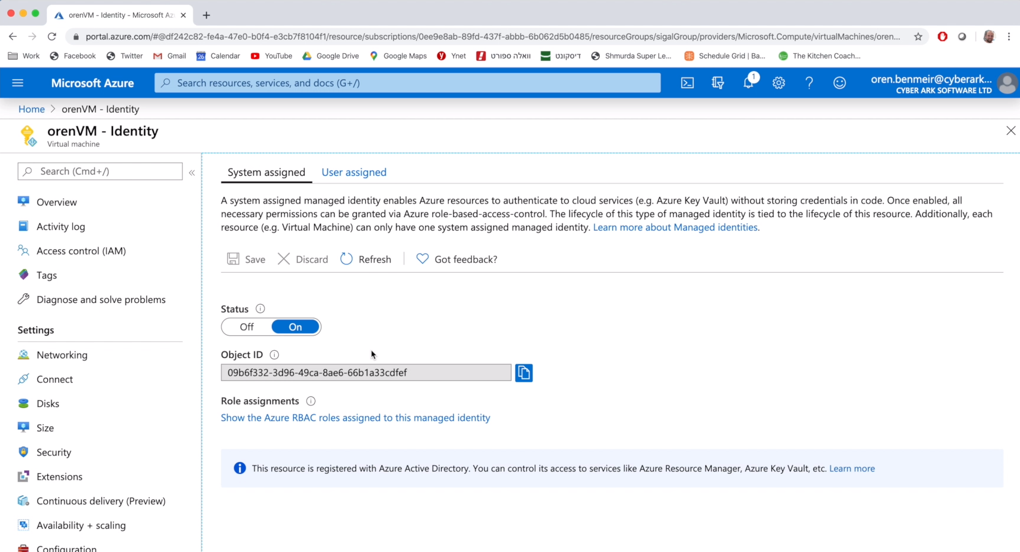
Azure Identity Option 2:
Subscription ID + Resource Group + System Assigned Identity
Identity definition in Conjur Policy yaml:

Slide 68
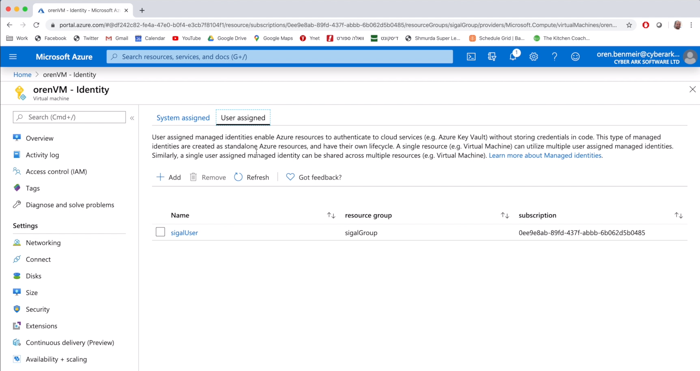
Azure Identity Option 3:
Subscription ID + Resource Group + User Assigned Identity
Identity definition in Conjur Policy yaml:

Slide 69
Policy Detail: Configure Azure authenticator ID named “prod”
---
- !policy
id: conjur/authn-azure/prod
body:
- !webservice
- !variable provider-uri
- !group
id: apps
annotations:
description: Role for authn to authn-azure/prod webservice
- !permit
role: !group apps
privilege: [ read, authenticate ]
resource: !webservice
Create Azure authentication webservice endpoint named “prod”
Define variable to hold https://sts.windows.net/{tenant-id}
Define prod/apps role
Permit apps group role to authenticate to
conjur/authn-azure/prod webservice

Slide 70
Policy Detail: Identity Definitions
---
- !policy
id: my-apps
body:
- !group
- &my-hosts
- !host rgrp1
annotations:
authn-azure/subscription-id: a01ff134-ae78-4497-b11c-7a698736b8a0
authn-azure/resource-group: JodyTest
- !host rgrp1-sid1
annotations:
authn-azure/subscription-id: a01ff134-ae78-4497-b11c-7a698736b8a0
authn-azure/resource-group: JodyTest
authn-azure/system-assigned-identity: 48268f7c-9470-4aff-97a9-fa6c736479f1
- !host rgrp2-uid1
annotations:
authn-azure/subscription-id: a01ff134-ae78-4497-b11c-7a698736b8a0
authn-azure/resource-group: Conjur-Demo
authn-azure/user-assigned-identity: Conjur-demo-UA-Identity
- !grant
role: !group
members: *my-hosts
- !grant
role: !group conjur/authn-azure/prod/apps
member: !group my-apps
Create Azure Identities
Grant my-apps group role to Azure Identities
Grant prod/apps role to azure-apps role

Slide 71
Policy Detail: Resource definition & access grant
---
- !policy
id: secrets
- !group consumers
- &vars
- !variable sub1-rgrp1
- !variable rgrp1-sid1
- !variable rgrp1-uid1
- !permit
role: !group consumers
privilege: [ read, execute ]
resource: *vars
- !grant
role: !group secrets/consumers
member: !host my-apps/rgrp1
- !permit
role: !host my-apps/rgrp1-sid1
privilege: [ read, execute ]
resource: !variable secrets/rgrp1-sid1
- !permit
role: !host my-apps/rgrp1-uid1
privilege: [ read, execute ]
resource: !variable secrets/rgrp1-uid1
Create secrets/consumers group
Create secrets (AKA variables)
Grant consumers read/exec access
Grant consumers role to resource group identity
Grant specific identities access to specific secrets

Slide 72
Crypto Details
Data at rest:
Database encryption uses 256-bit AES.
Master keys are encrypted with 256-bit AES.
Signed tokens use asymmetric RSA with 2048 modulus.
Password hashing is done with one-way bcrypt, with a work factor of 12.
Data in motion:
All access uses HTTPS (UI and API calls)
TLS 1.2 protocol only. No older TLS or SSL protocols supported.
Lowest strength cipher key size that can be negotiated is 128-bit, highest is 256-bit.
Diffie-Hellman key exchange within TLS sessions uses 3072-bit discrete logarithm group size, or 256-bit elliptic curve.

Slide 73
Credential Providers

Slide 75
Evolution of Application Access Manager
Monolith
Virtualized
Containerized
Micro Services
All need access to secrets and other credentials. Some are very short-lived.
Increased: agility, pace, automation, automation tools

Slide 76


Secrets Management
From mainframe to microservices
Enterprise
Open Source
CyberArk Application Access Manager
Credential Provider
App Server Credential Provider
Central Credential Provider
Dynamic Access Provider
Windows/ *nix / zOS
(agent)
Application Servers (agent)
Windows/ *nix
(agentless)
Devops, Cloud and Containers
Notes:
Going forward, these are the three areas of focus from an innovation point of view

Slide 77

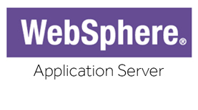



Application Server Credential Provider
DATA SOURCE
REFERENCE
API CALL
Client Application
Application Server
ASCP
DataSource customerDataSource = (DataSource)
context.lookup("java:comp/env/jdbc/customer_db")
Local secure caching
High-availability
Enhanced auth & anti-tampering
J2EE App Sever
Minimal code changes
Username = GetUserName()
Password = GetPassword()
Datasource
CyberArk Vault

Slide 78




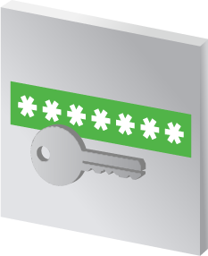






Traditional Application Access: High level perspective
Application Identity Management
Applications
Application Servers (WebSphere, Weblogic, etc.)
Secure Storage
Databases
Security Appliances
*****
Applications
Unix Servers
CyberArk Vault
Password and SSH Key Rotation
Network Devices
Servers
Applications
Windows Servers
Username = GetUserName()
Password = GetPassword()
Host = GetHost()
ConnectDatabase(Host, Username, Password)
Username =
Password =
Host =
ConnectDatabase(Host, Username, Password)
“app”
“y7qeF$1”
“10.10.3.56”
Websites/ Web Apps
Cloud Infrastructure
Applications
Mainframe Servers
Applications
Desktops
Notes:
Applications can reside anywhere in an organization, be it servers or desktops. Unix Servers, Windows Servers, Mainframes, Application servers, such as WebSphere, Weblogic, etc.
<CLICK 1>
Typically, these applications will need to connect to a remote resource, such databases, web application, cloud infrastructure, and even simply other servers.
In order to connect and communicate with these resources, the application must use credentials, and as we saw earlier these credentials are naturally hard-coded into the application code, which expose them to attackers and insider threats.
<CLICK 2>
Moreover, these credentials are almost never changed, because they have been hard-coded into tons of applications throughout the organization.
How does CyberArk overcome these challenges?
First thing’s first – remove the hard-coded credential from the application code.
CyberArk Application Identity Manager enables the complete elimination of hard-coded and embedded credentials in applications by replacing them with SDKs. The credential are stored in Vault, and are retrieved using the SDK inside the application code.
Credentials, be it password or SSH keys, can then be easily rotated based on the organization policy and the application will transparently use these new credentials whenever required,
Let’s have a look at how this works.
Attackers or malicious insiders will eventually get access to these credentials, so what we need to do is store them in the Vault
<CLICK 3>
This will secure them and enable their frequent rotation
Then, we must get rid of these hard-coded credentials <CLICK 4> and replace them with SDK calls
<CLICK 5>
This will enable applications to retrieve the credentials stored and secured in the Vault
<CLICK 6> When a credential is required by an application it is retrieved from the Vault to the application, and then used to authenticate to whichever resource it is required.
And this summarized the high-level concept of AIM – Application Identity Manager.
Let’s now go on and discuss all of AIM’s benefits
<CLICK 7>

Slide 79



But why change code? J2EE
Integration with Java Application Servers enables the transparent management of datasource credentials for: WebSphere, WebLogic, JBoss, Tomcat
Requires no code changes to the J2EE application. One-time configuration change to the application server.
Server
WebSphere
J2EE
Application
Database
Application Server Credential Provider
CyberArk Vault
Notes:
The third solution included in AIM, is a solution for Java Application Servers.
This is a solution for the transparent management of datasource credentials, the credentials used by the application servers to connect to databases and other assets at the heart of the enterprise.
<CLICK 1>
Among the SDKs CyberArk AIM offers is a Java SDK, through which Java applications can retrieve credentials, as we have seen in the previous slides.
But why change the code of all application when you can make a one time configuration change in the Application Server itself?
CyberArk has developed and patentized an innovative solution that eliminates hard-coded credentials in Java Applications servers without needing to change a single line of code, which as we know, can be a big challenge to orchestrate.
<CLICK 2>
The Application Server Credential Provider is installed on the Java Application Server, just like the Credential Provider we saw in the previous slides.
<CLICK 3>
Similar to the Credential Provider, everytime the Java application requires a credential, it is retrieved from the Vault, stored in the cache, and the connection is established by the Java Application Server.
The credential never makes it to the application itself.
The Application Server Credential Provider is very popular for the beginning of AIM projects, since it requires no code changes, and is very easy to implement.

Slide 80

But why change code? J2EE
Integration with Java Application Servers enables the transparent management of datasource credentials for: WebSphere, WebLogic, JBoss, Tomcat
Requires no code changes to the J2EE application. One-time configuration change to the application server.
Server
WebSphere
J2EE
Application
Database
Application Server Credential Provider
CyberArk Vault
Notes:
The third solution included in AIM, is a solution for Java Application Servers.
This is a solution for the transparent management of datasource credentials, the credentials used by the application servers to connect to databases and other assets at the heart of the enterprise.
<CLICK 1>
Among the SDKs CyberArk AIM offers is a Java SDK, through which Java applications can retrieve credentials, as we have seen in the previous slides.
But why change the code of all application when you can make a one time configuration change in the Application Server itself?
CyberArk has developed and patentized an innovative solution that eliminates hard-coded credentials in Java Applications servers without needing to change a single line of code, which as we know, can be a big challenge to orchestrate.
<CLICK 2>
The Application Server Credential Provider is installed on the Java Application Server, just like the Credential Provider we saw in the previous slides.
<CLICK 3>
Similar to the Credential Provider, everytime the Java application requires a credential, it is retrieved from the Vault, stored in the cache, and the connection is established by the Java Application Server.
The credential never makes it to the application itself.
The Application Server Credential Provider is very popular for the beginning of AIM projects, since it requires no code changes, and is very easy to implement.

Slide 81
Powershell script authentication with ccp
$AppID = "App_MyApp"
$object = ”epv-account-id"
$CCPAddress = "https://CyberArkCCP/WindowsAuthentication/api/Accounts?AppID=$AppID&Object=$object"
$restresponse = ""
$restresponse = invoke-restmethod -uri $CCPAddress -method GET -UseDefaultCredentials
Windows HTTP client stack provides AD domain credentials w/o including them in the script
Transparent NTLM authentication
http://patelshailesh.com/index.php/how-windows-authentication-works-with-iis-http-sys-kerberos-ntlm
CCP’s IIS server authenticates credentials with AD
Also supported from Java and C# apps:
https://stackoverflow.com/questions/54568189/how-to-provide-ntlm-authentication-while-calling-any-url
https://docs.microsoft.com/en-us/dotnet/api/system.net.webclient.usedefaultcredentials?view=net-5.0

Slide 82
Pivotal Cloud Foundry

Slide 83
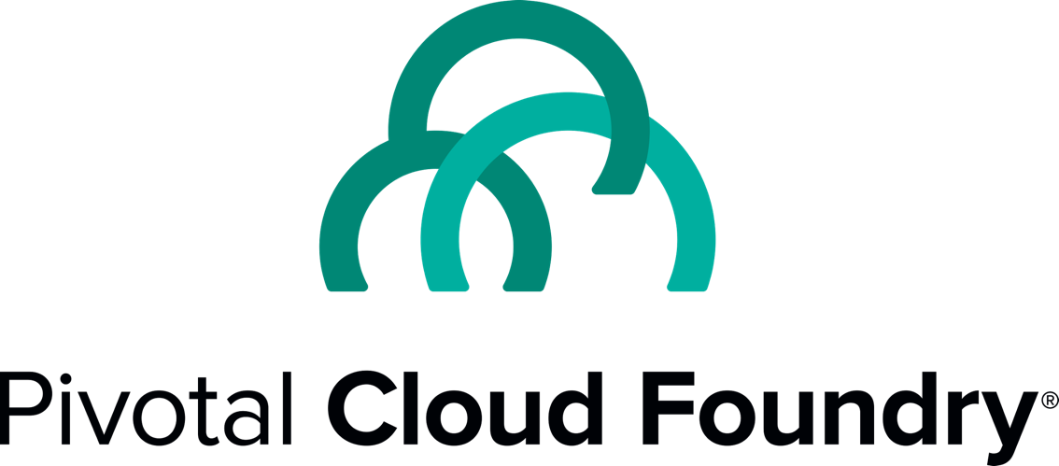
Pivotal Cloud Foundry
Industry leading Platform-as-a-service.
Enables high velocity continuous delivery of applications.
Simplifies operations by offering a nearly complete ecosystem for developing applications.
Large footprint in the enterprise. Customers include CITI, The Home Depot, JPMC, Boeing, and many more
Notes:
Key takeaway: CyberArk and Pivotal are working together to secure Pivotal Cloud Foundry.

Slide 84
Key Benefits
Secrets managed by CyberArk and Conjur are delivered securely to applications running in Pivotal Cloud Foundry
No developer impedance. Seamlessly integrated into the PCF Environment and Developer Workflow.
Security teams enabled to bring security best practices to PCF and meet compliance requirements

Slide 85
Components
Open Service Broker Within the Pivotal Cloud Foundry ecosystem, the Service Broker pattern has emerged as the standard for integrating services. The Service Broker pattern implements the Open Service Broker API standard it is backed by the Linux Project Foundation.
Summon Buildpack Buildpacks provide framework and runtime support for apps. Buildpacks typically examine your apps to determine what dependencies to download and how to configure the apps to communicate with bound services. The Summon Build Pack installs and configures Summon. Summon is a an lightweight, open source tool provided by CyberArk for securely injecting secrets into a process.
Conjur Conjur is an enterprise-ready secrets management solution for cloud and DevOps environments. Open source version of Conjur is available at conjur.org.

Slide 86
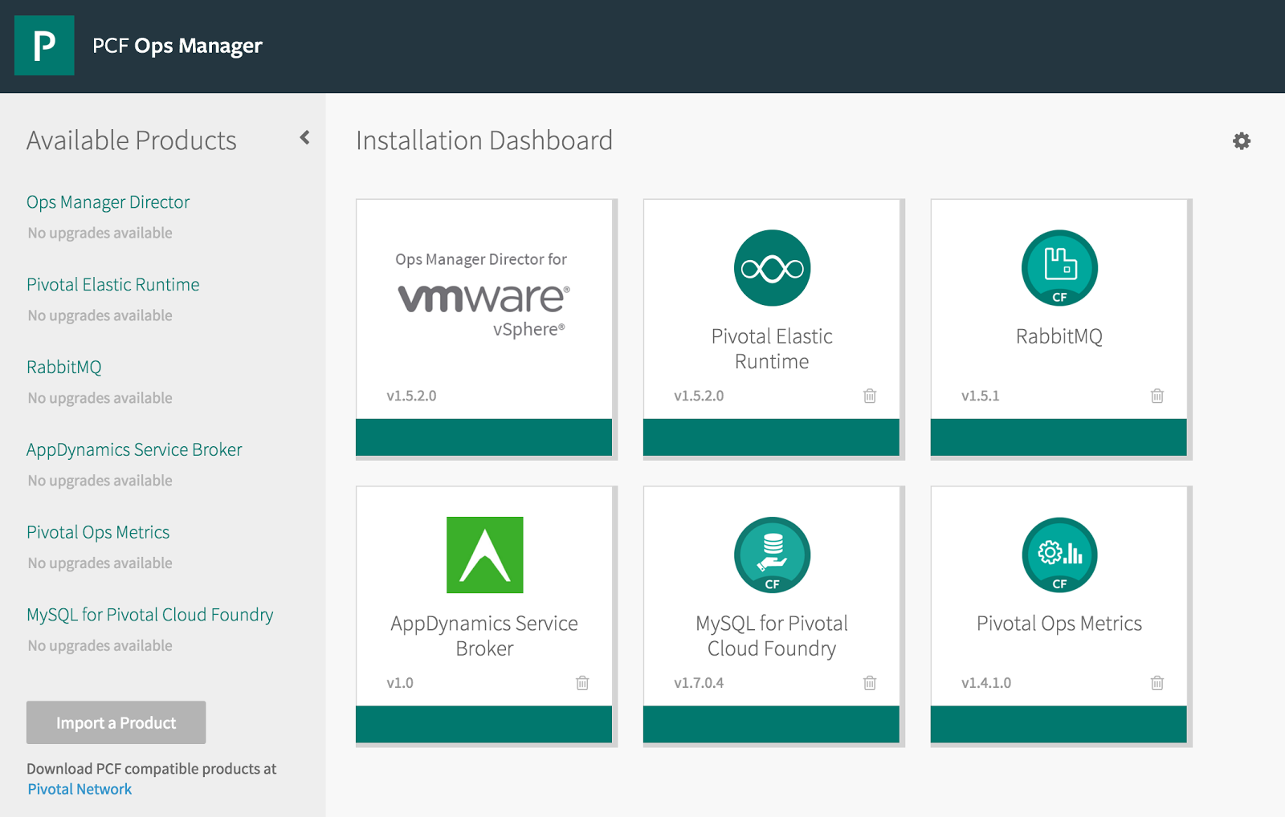
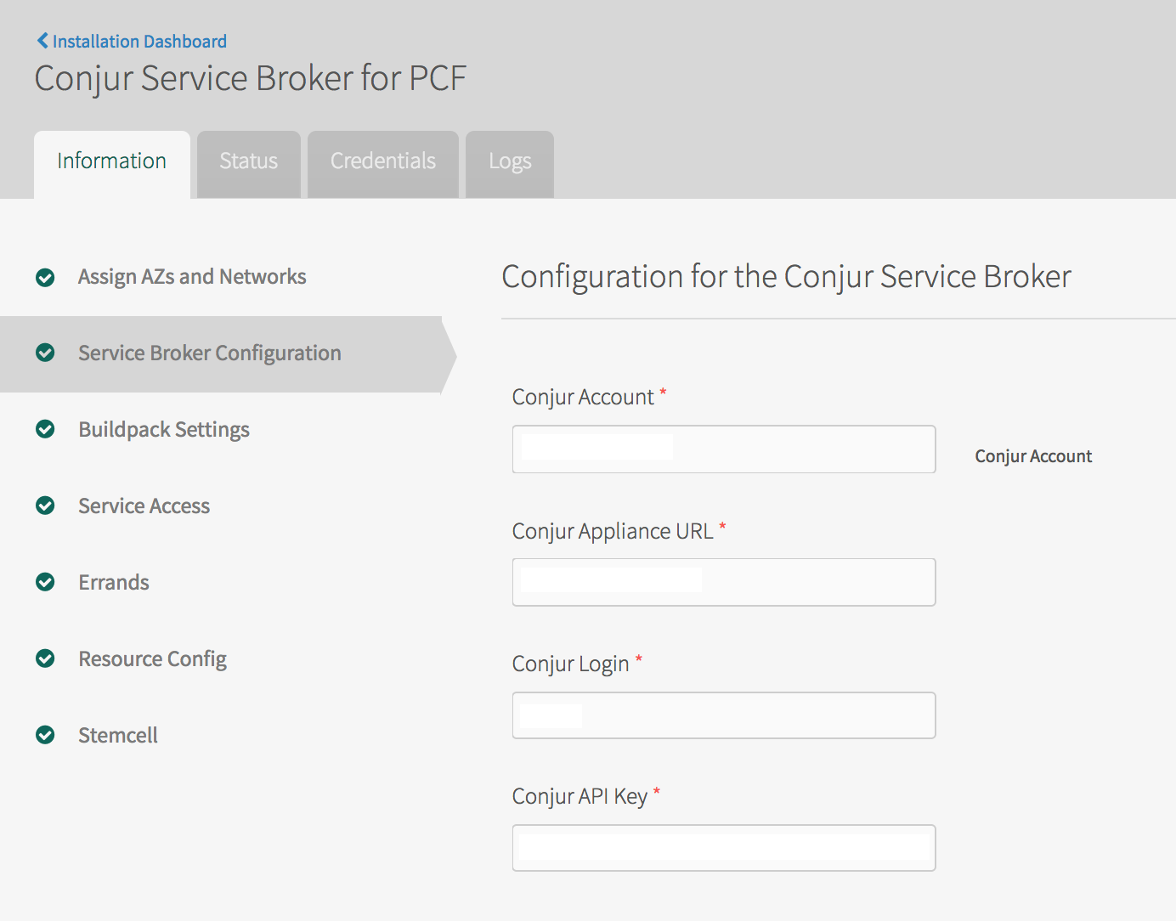
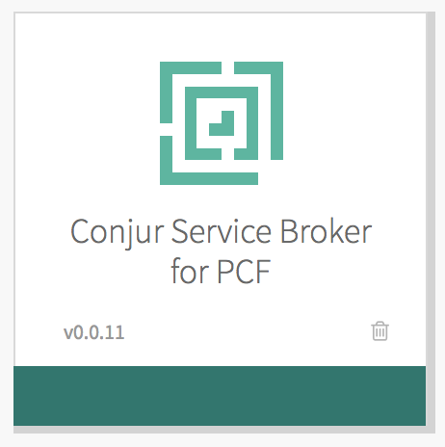
Service is installed and configured via the Ops Manager
Installing and Configuring CyberArk Conjur Service Broker for PCF
Notes:
Key takeaway: Install the Conjur service like you would any other PCF service.

Slide 87
Developer Workflow
Prepare the Application by adding a secrets.yaml file with references to the secrets your application needs.
Create a service instance in the space where you intend to deploy the application.
Add the instance name to your application manifest (if you are using manifest)
Push the application without starting it
Update Conjur policy grants with binding id for your application
Restage the application
Using CyberArk Conjur Service Broker

Slide 88
Under The Hood
Pivotal Cloud Foundry
4 Create Identity for Application
CyberArk Conjur Tile
1. Install & configure the service with the Conjur tile
CyberArk-Conjur Service Broker
Summon Buildpack
5. Issue credentials
6. Pass credentials
3. Bind Application to Service
CyberArk-Conjur
Follower Instance
2. When the application is started for the first time the Buildpack installs Summon
Application
8. Authenticate and request values
7. UpdateConjur policy to grant secret access to the app’s identity
CyberArk Summon
9. Inject secret values
Notes:
The source of a Conjur hostname in PCF (e.g. pcf/54ddaf3b-1ff6-488e-bdab-655f84b3ffbe) is the binding ID, which is unique to the application's Service Instance's binding to the Conjur Service Broker. The Service Instance and binding ID are created when the application binds to the Service Broker on initial push. The host identity is dynamically created in Conjur using a host factory, with the hostname name as "pcf/<binding ID>" and an associated API key. Those credentials (hostname & API key) are cached as part of the application's environment in the VCAP_SERVICES environment variable credentials attribute. The binding ID is unique to the push of the app, which may have multiple instances sharing the same Service Instance and using the same hostname/API key for Conjur authentication (i.e. the application instances all share the same identity). Restarting an app instance or deploying new instances doesn't refresh the binding. That only changes if the app is explicitly unbound from the service instance and is subsequently re-pushed (see https://docs.cloudfoundry.org/devguide/services/managing-services.html#unbind).

